Slide 1
Derived Types

Slide 2
Chapter 12
Derived Types--
Enumerated,
Structure

Slide 3
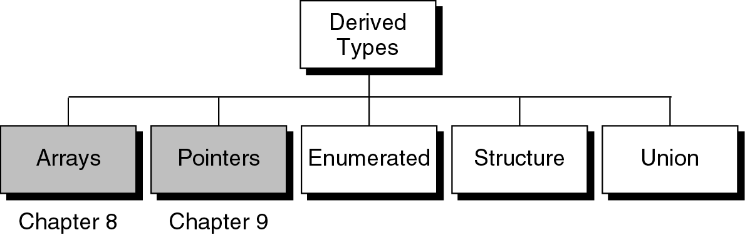
Figure 12-1

Slide 4
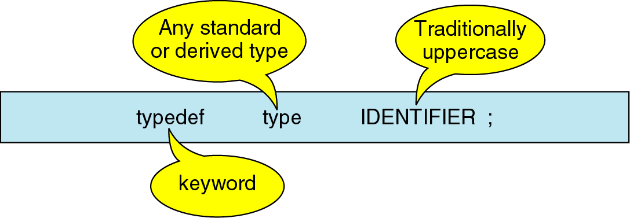
Figure 12-2 type definition format
A typedef gives a name to a data type by creating a new type that can then be used wherever a type is permitted
Adv: to replace a complex name with an easier mnemonic
To be coded in uppercase for easier readability
Ex:
    Replacing char *stringPtrArray[20] by typedef
    typedef char * STRING;
    STRING stringPtrArray [20];

Slide 5
Enumerated Types

Slide 6
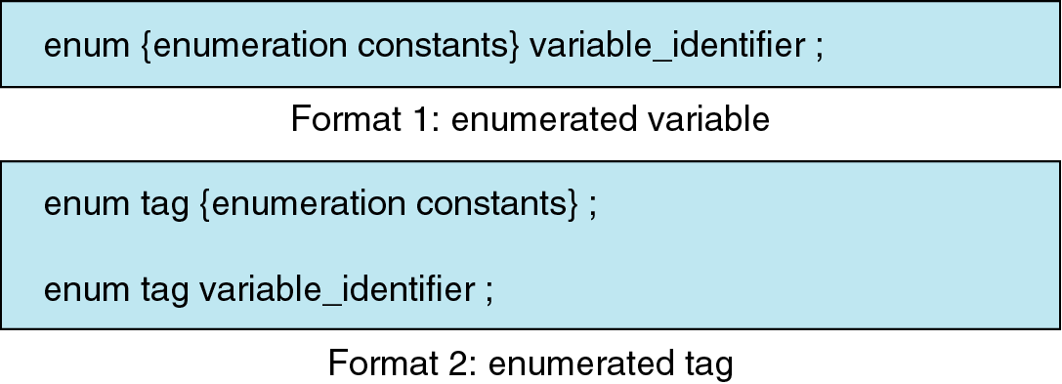
Figure 12-3

Slide 7
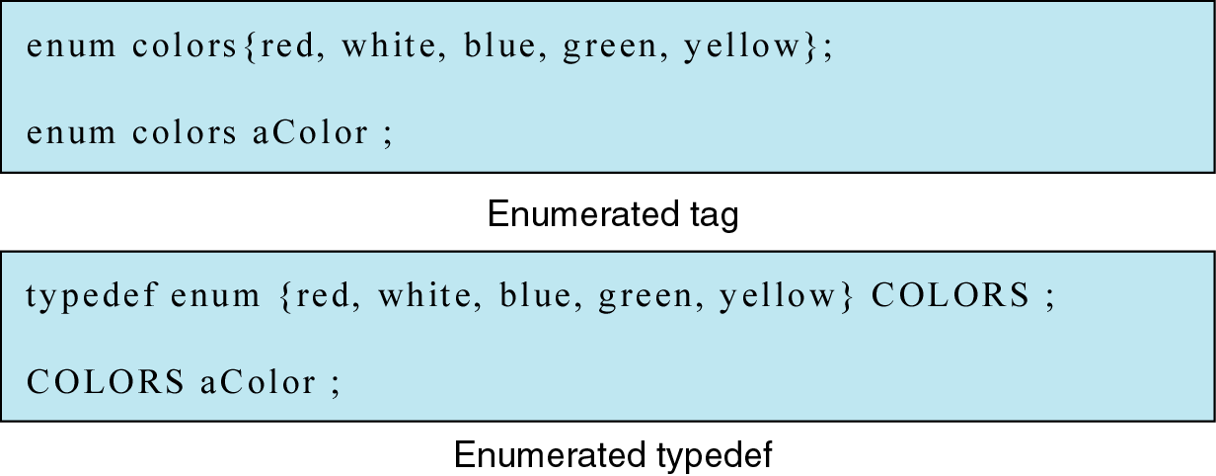
Figure 12-4

Slide 8
Structures

Slide 9
Structure
Structure – a collection of related elements, possibly of different types, having a single name
Field – each element in a structure is called a field
  Same as variable in that it has type and exists in memory
  Differs from a variable in that it is a part of structure
Structure vs. array
  Both are derived data types that can hold multiple pieces of data
  All elements in an array must be of the same type, while the elements in a structure can be of the same or different types

Slide 10
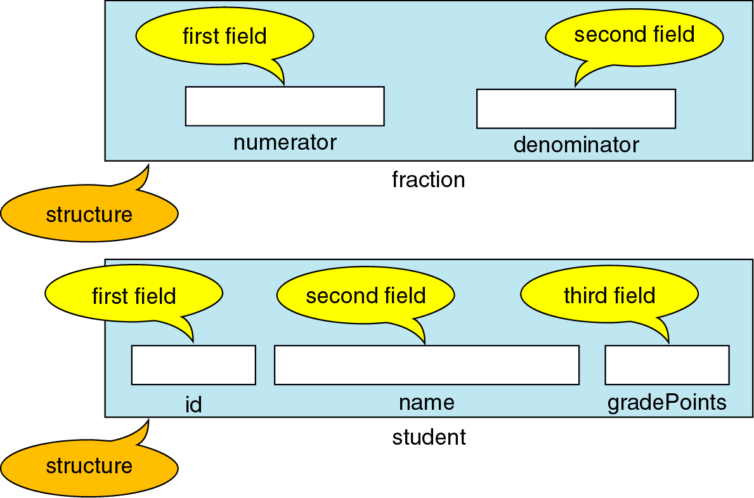
Figure 12-6 Structure Examples
Note: the data in a structure should all be related to one object
Ex1: both integers belong to the same fraction
Ex2: all data relate to one student

Slide 11
Structure – declaration and definition
Keyword struct – informs the compiler that it is a collection of related data
3 ways to declare/define a structure in C
Structure variable
Tagged structure
Type-defined structure

Slide 12
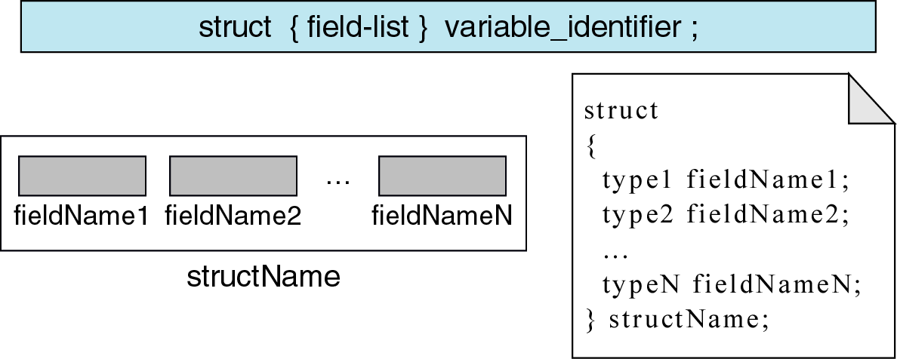
Figure 12-7 structure variable
Note: The above definition creates a structure for only one variable definition
As there is no structure identifier (tag), it cannot be shared
So, it is not really a type
This type of declaration format not to be used

Slide 13
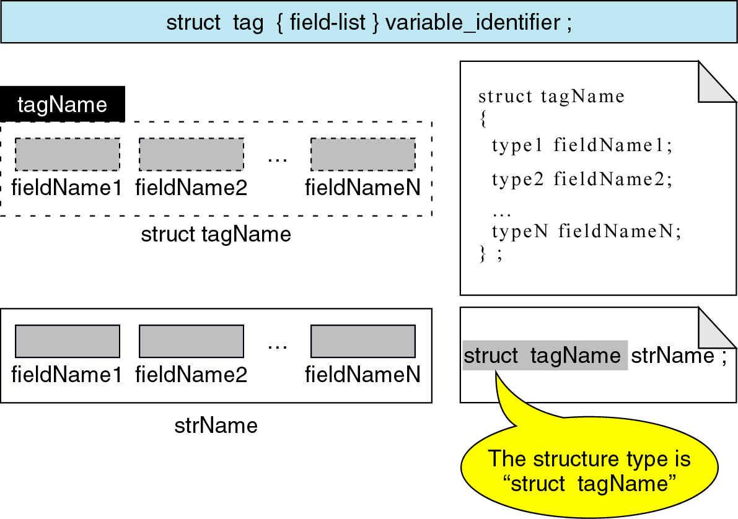
Figure 12-8 Tagged structure

Slide 14
Tagged Structure – declaration and definition
struct tagname – tagname is the identifier for the structure
  allows to define variables, parameters, and return types
If a struct is concluded with a semicolon after the closing brace, no variables are defined
  So structure is a type template with no associated storage
To define a variable at the same time we declare the structure, list the variables by comma separation

Slide 15
Tagged Structure – declaration and definition
Ex: declare and use student structure:
struct student{
char id[10];
char name[20];
int gpa;
};
struct student astudent;
void printStudent( struct student stu);

Slide 16
Tagged Structure – declaration and definition
struct student{
char id[10];
char name[20];
int gpa;
};
struct student astudent;
void printStudent( struct student stu);
Follow the above format of declaring structure first and then define variables
  Declare structure declaration in the global area of the program before main
  So structure declaration scope is global and can be shared by all functions

Slide 17
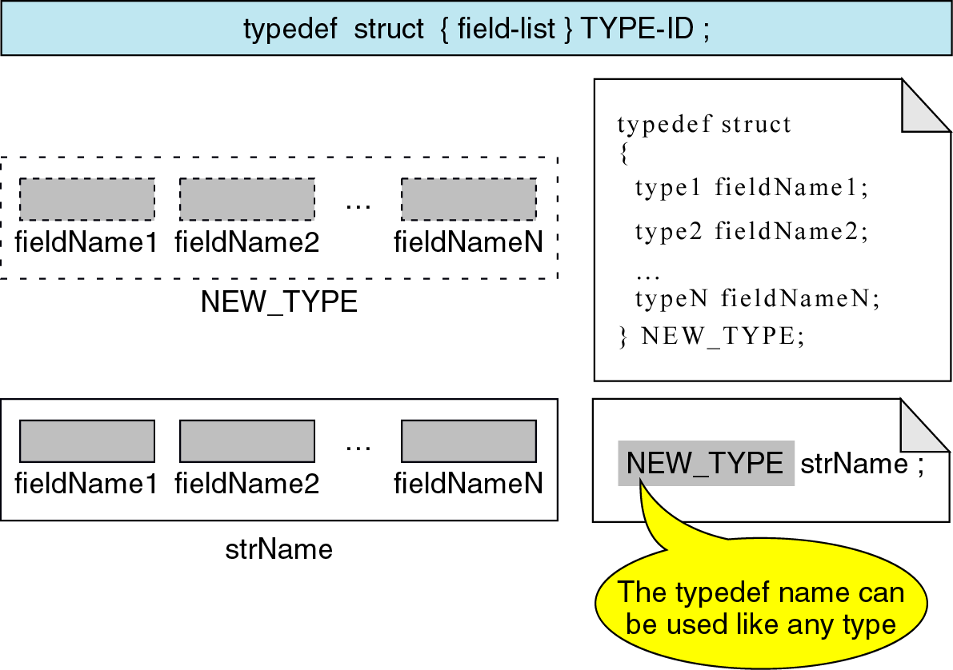
Figure 12-9 Type defined structure

Slide 18
Type defined Structure – declaration and definition
Ex: declare and use student structure:
typedef struct {
char id[10];
char name[20];
float gpa;
} STUDENT;
STUDENT astudent;
void printStudent(STUDENT stu);

Slide 19
Type defined Structure – declaration and definition
The most powerful way to declare a structure is by typedef
Typedefined vs. tagged structure declaration
  Typedef is to be added before struct
  Identifier at the end of the block is the type definition name not a variable
  Cannot define a variable with the typedef declaration
typedef struct {
char id[10];
char name[20];
float gpa;
} STUDENT;
STUDENT astudent;
void printStudent(STUDENT stu);

Slide 20
Type defined Structure – declaration and definition
It is possible to combine the tagged structure and type definition structure in a tagged type definition
The difference between tagged type definition and a type defined structure is
  Here, the structure has a tag name in tagged type definition
typedef struct tag {
char id[10];
char name[20];
float gpa;
} STUDENT;
STUDENT astudent;
void printStudent(STUDENT stu);

Slide 21
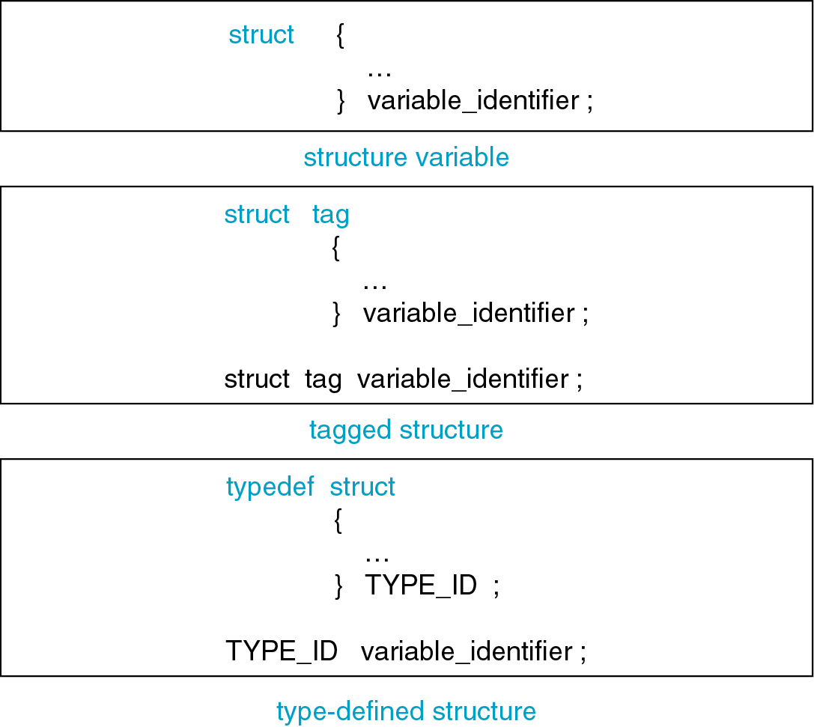
Figure 12-10 struct format variations

Slide 22
Initializing structures
Rules for structure initialization are similar to rules of array initialization
  The initializers are enclosed in braces and comma separated
  They must match their corresponding types in the structure definition
  For a nested structure, the nested initializes must be enclosed in their own set of braces

Slide 23
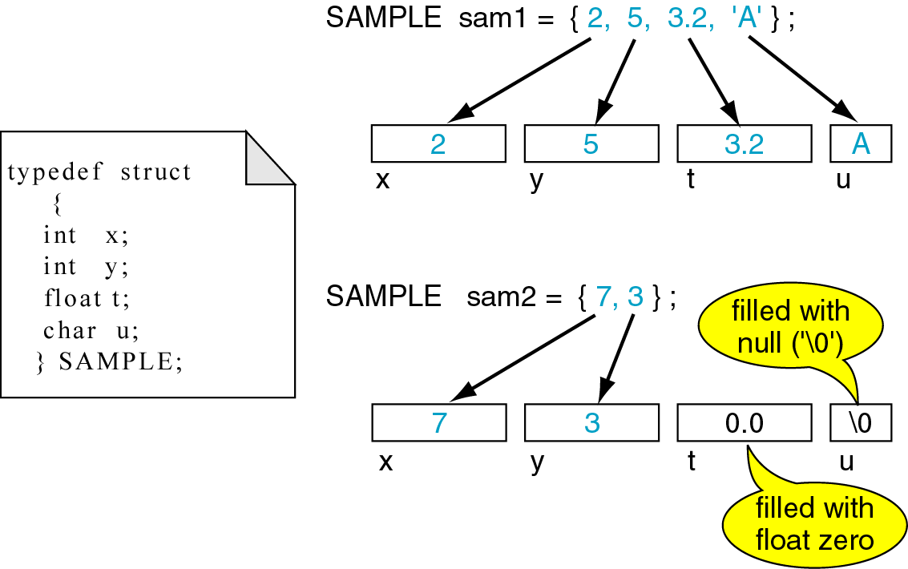
Figure 12-11 Initializing structures
Ex1: initializer for each field is given – mapped sequentially to their types
Ex2: initializer for some fields are only given – structure elements will be assigned null values – zero for integers and floating point numbers, \0 for chars and strings (same as in arrays)

Slide 24
Accessing structures
Same way as we manipulate variables using expressions and operators, the structure fields can also be operated
Ex:
typedef struct {
char id[10];
char name[20];
float gpa;
} STUDENT;
STUDENT astudent;
Refer to fields by
astudent.id, astudent.name, astudent.gpa

Slide 25
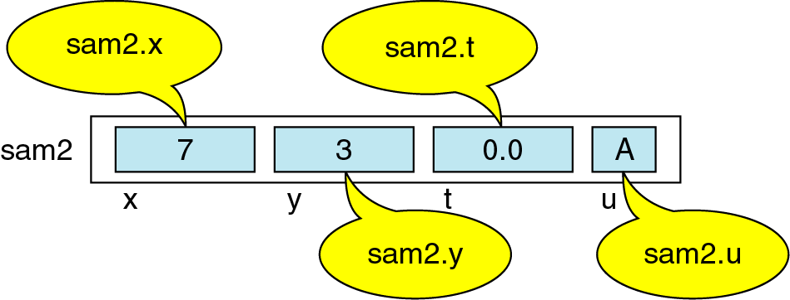
Figure 12-12 structure member operator
Accessing structures
Ex: Reading data into and writing data from structure members is same as done for variables
Scanf(“%d %d %f %c”, &sam1.x, &sam1.y, &sam1.t, &sam1.u);

Slide 26
Precedence of Member operator
Similar to operator [] for array indexing, dot is member operator for structure reference
1) The precedence of member operator is higher than that of increment
Ex: sam2.x++; ++sam2.x;
No parentheses are required
2) &sam1.x is eqt to &(sam1.x). So dot has higher priority than & operator

Slide 27
Structure Operations
Assignment operation : assigning one structure to another
Structure is treated as one entity and only one operation ie., assignment is allowed on the structure itself
To copy one structure to another structure of the same type
  Rather than assigning individual members
  Assign one to another
Ex: read values into sam1 from the keyboard. Now copy sam1 to sam2 by
sam2=sam1;

Slide 28
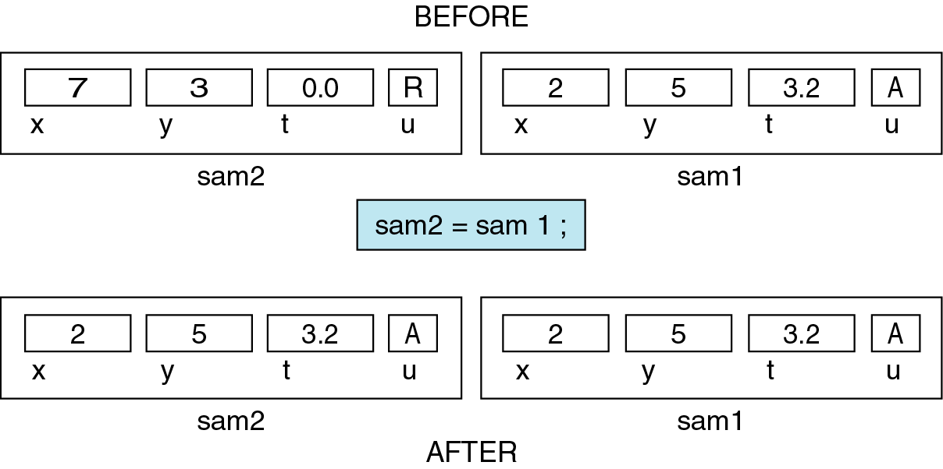
Figure 12-13 Copying a structure

Slide 29
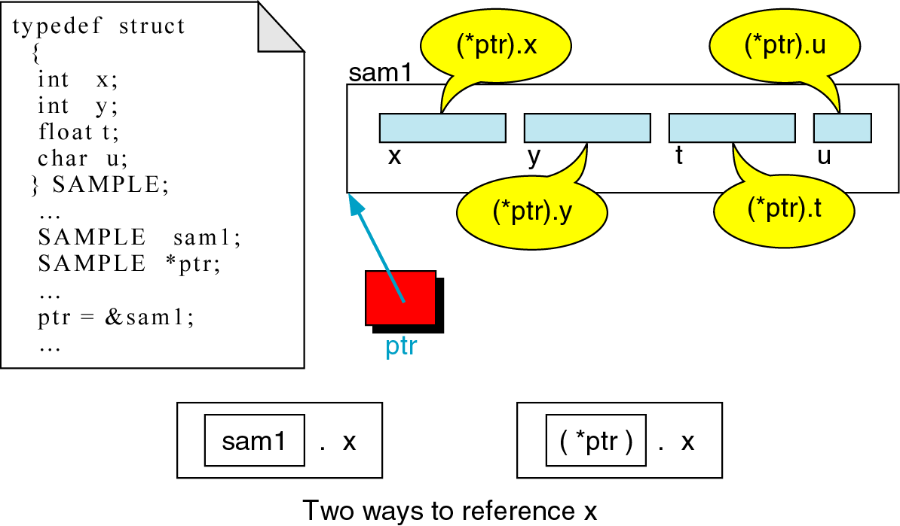
Pointer to structures
Like other types, structures can also be accessed through pointers
Accessing structure itself by *ptr
ptr contains the address of the beginning of the structure,
Now we do not only need to use structure name with member operator such as sam1.x
we can also use (*ptr). x

Slide 30
Figure 12-14 Pointers to structures

Slide 31
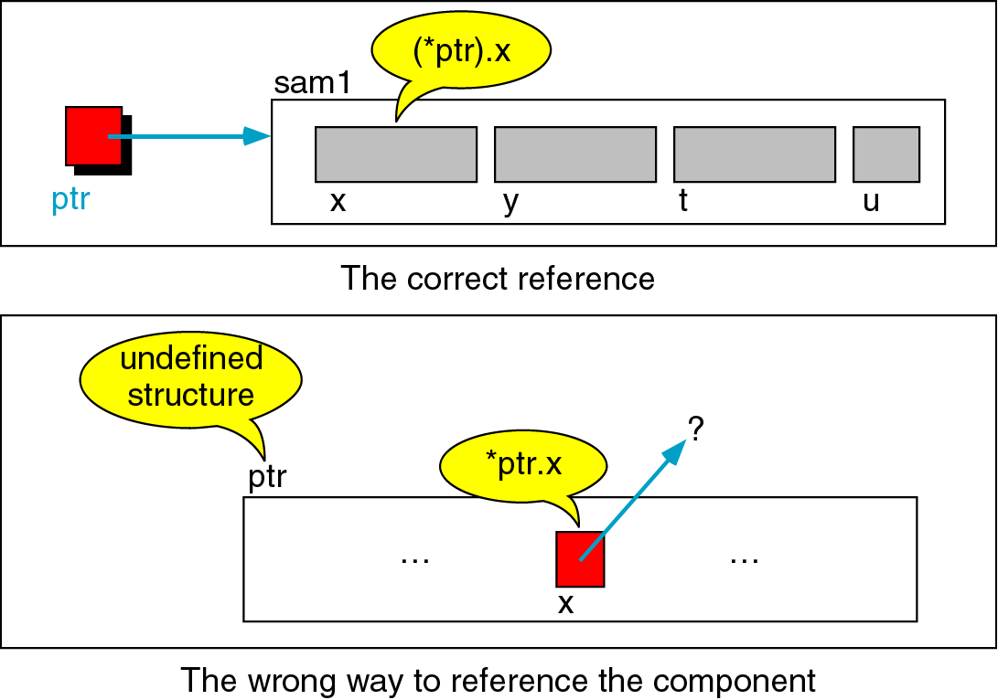
Figure 12-15 Interpretation of invalid pointer use
In the expression (*ptr).x, parentheses are necessary as member operator has more priority than indirection operator
Default interpretation of *ptr.x is *(ptr.x) which is error because it means that there is a structure called ptr (undefined here) containing a member x which must be a pointer
So, a compile-time error is generated as it is not the case

Slide 32
Selection operator
However, there is a selection operator -> (minus sign and greater than symbol) to eliminate the problem of pointer to structures
The priority of selection operator (->) and member operator(.) are the same
The expressions
(*pointerName).fieldName is same as pointerName -> fieldName
But pointerName -> fieldName is preferred

Slide 33
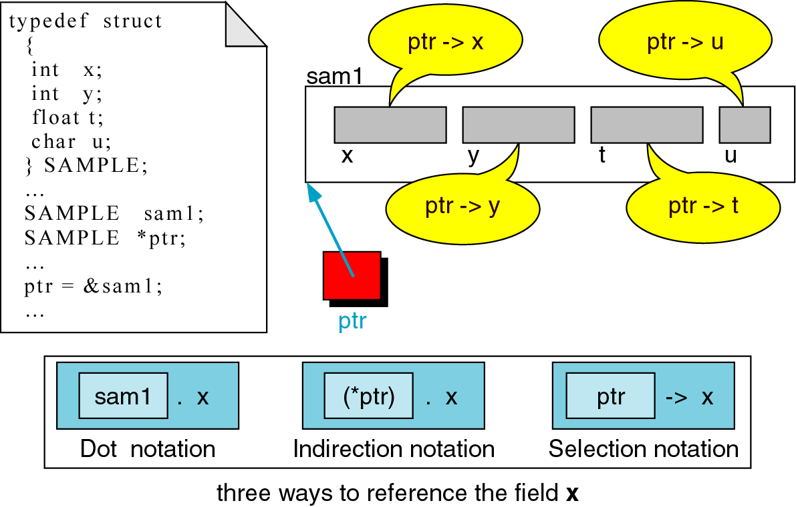
Figure 12-16 pointer selection operator

Slide 34
COMPLEX STRUCTURES

Slide 35
Complex Structures
Structures to solve complex problems
structures within structures (nested structures)
arrays within structures
arrays of structures etc.

Slide 36
Nested Structures
When a structure includes another structure, it is a nested structure
Here, we can have structures as members of a structure

Slide 37
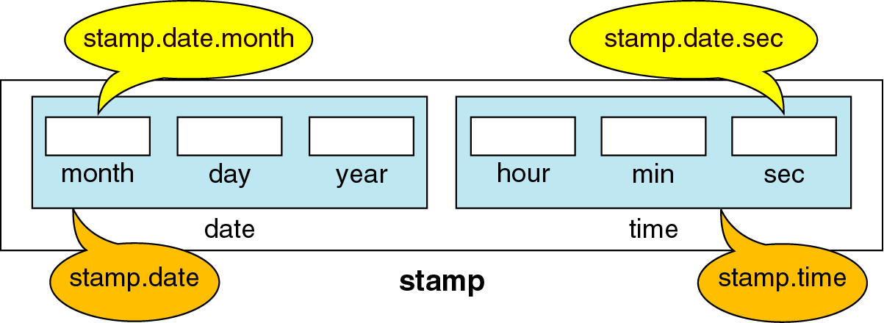
Figure 12-17 Nested structure
Stamp.time.sec
A structure called stamp stores the date and time
The date is a structure that stores date, month and year
The time is a structure that stores hour, minute and second

Slide 38
Nested Structures – declaration and referencing
Preferred
typedef struct {
int month;
int day;
int year;
} DATE;
typedef struct {
int hour;
int min;
int sec;
} TIME;
typedef struct {
DATE date;
TIME time;
} STAMP;
STAMP stamp;
Not recommended
typedef struct {
  struct{
  int month;
  int day;
  int year;
  } date;
  struct {
  int hour;
  int min;
  int sec;
  } time;
} STAMP;
STAMP stamp;
Preferred – simpler to declare each structure separately and then group it in a higher level structure
Not recommended – complex to declare a nested structure with one declaration

Slide 39
Nested Structures – declaration
In preferred notation
  Declare the structures separately
  Nesting must be from inside to out
  So declare innermost structure first, then the next level working upward, toward the outermost structure
Ex: in stamp structure
  Date and time is declared first
  Outer structure stamp is then declared

Slide 40
Nested Structures – declaration
Same structure type can be used in a new structure declaration
  Ex: using STAMP, we can declare a new structure JOB
  typedef struct {
  STAMP startTime;
  STAMP endTime;
  } JOB;
  JOB job;
Preferred notation
  Allows flexibility
  Ex: DATE is declared as a separate type definition
  So it is possible to pass the DATE structure to a function without having to pass STAMP

Slide 41
Nested Structures –referencing
Accessing a nested structure
from the highest level to the member of the innermost structure
Ex: referencing stamp:
stamp
stamp.date
stamp.date.month
stamp.date.day
stamp.date.year
stamp.time
stamp.time.hour
stamp.time.min
stamp.time.sec
Job. startTime.time.hour
Job.endTime.time.hour

Slide 42
Nested Structure - Initialization
Same as rules of a simple structure
Initialize each structure completely before proceeding to the next member
Each structure is enclosed in a set of braces
Ex: Initializing stamp
  Initialize date and then time separated by comma
  Initializing date involves providing values for month, day , year each separated by commas
  Initializing time involves providing values for hour, min, sec
Ex: defining and initialization for stamp
STAMP stamp = { {8, 18, 2014}, {08, 40, 50} };

Slide 43
Structures containing arrays
Structures can have arrays as members
The array can be accessed by index or through pointers
As with nested structure, arrays can be included within the structure or may be declared separately and then included
If the array is declared separately, then the declaration must be complete before it can be used in the structure
Ex: student structure

Slide 44
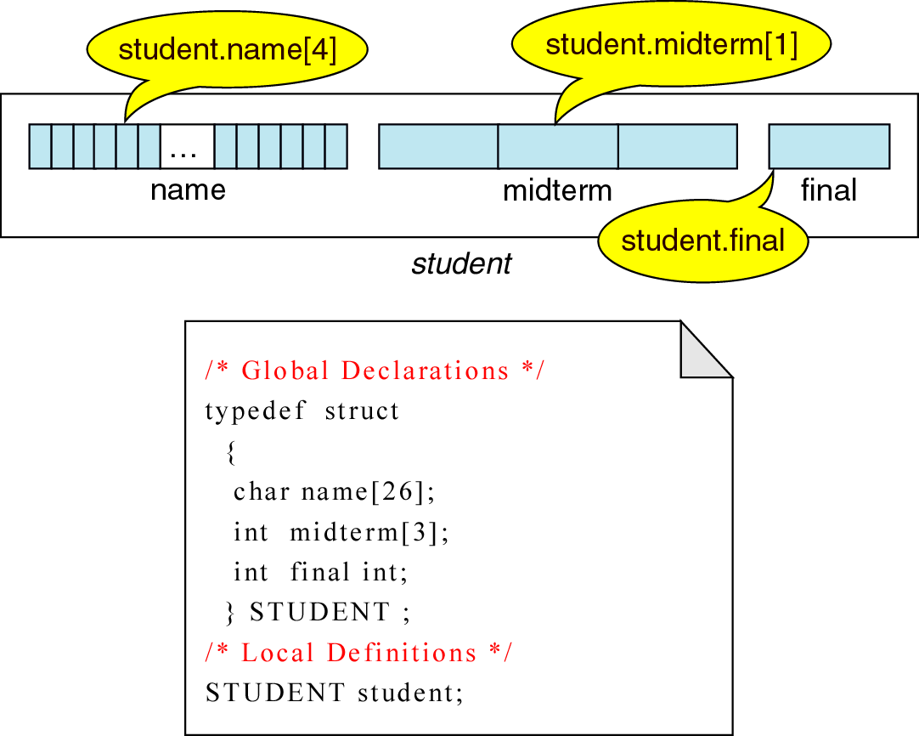
Figure 12-18 Arrays in structures
Student structure contains 2 arrays

Slide 45
Structures containing arrays
Ex: student structure – referencing through index
student
student.name
student.name[i]
student.midterm
student.midterm[j]
student.final

Slide 46
Structures containing arrays
Ex: student structure – referencing through pointer
For an array, we can always use a pointer to refer directly to the array elements
Ex: referring scores in student structure
int *pScores
pScores = student.midterm;
totalscores = *pScores + * (pScores +1) + * (pScores +2)

Slide 47
Structures containing arrays
Array initialization in structures
Same rule of structure initialization
Since array is a separate member, its values must be included in a separate set of braces
Ex: student structure initialization
STUDENT student = {“name1”, {10, 20, 30}, 40};

Slide 48
Structures containing pointers
The use of pointers can save memory
typedef struct
{
char *month;
int day;
int year;
} DATE;

Slide 49
Structures containing pointers
The use of pointers can save memory
Suppose, we want alphabetic month in stamp structure and not integer month
Alternative 1: add char month[9] as structure member
Alternative 2: add char *month as structure member
typedef struct
{
char *month;
int day;
int year;
} DATE;
Given the months of the year defined as strings
char jan[] = “January”;
char feb[] = “February”;
char dec[] = “Decenber”;
Assigning month to the structure is now by copying a pointer to the string
stamp.date.month = may;
typedef struct
{
char month[9];
int day;
int year;
} DATE;

Slide 50
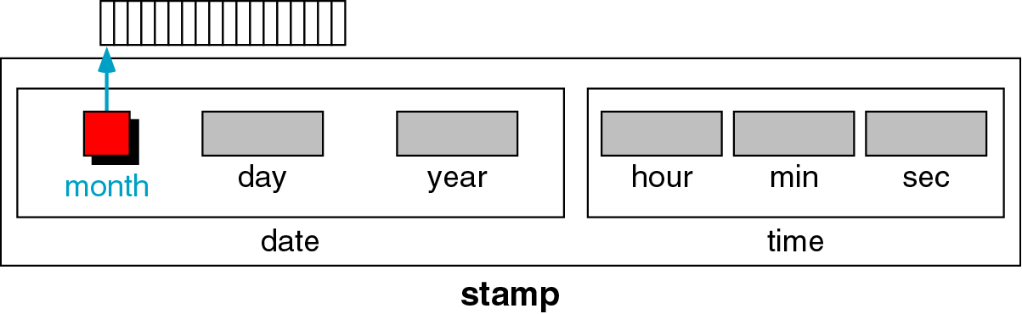
Figure 12-19 Pointers in Structures

Slide 51
Array of Structures
In an array, we can easily work with data – to calculate average, sorting etc.

Slide 52
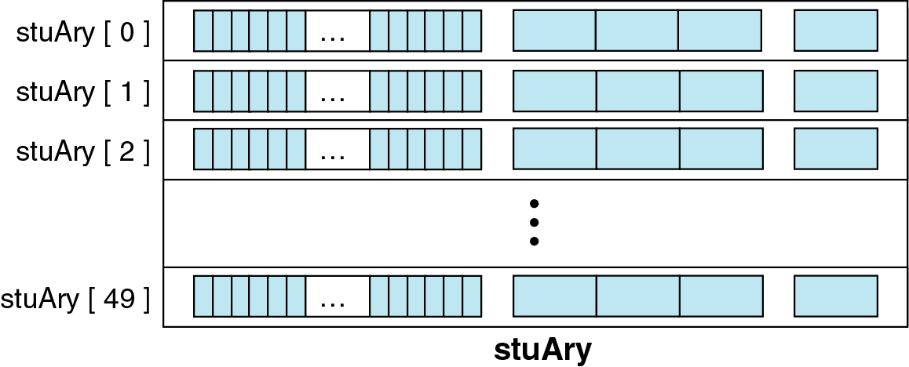
Figure 12-20 Array of structures
Defining STUDENT stuAry[50];
Accessing by index stuAary[i]
Accessing by pointer *pstu

Slide 53
Array of Structures (using pointers)
Finding the average of final marks
#define SIZE 10
typedef struct{
char name[25];
int midterm[3];
int final;
}STUDENT;
STUDENT stuary[10];
int i, sum = 0;
float average;
STUDENT *pwalk;
STUDENT *plast;
plast = stuary+SIZE -1;
for( pwalk = stuary; pwalk <= plast; pwalk++)
sum = sum + pwalk -> final;
average = sum/ (float)SIZE;

Slide 54
Array of Structures (using pointers)
Finding average of each mid term marks with pointers
#define SIZE 10
typedef struct{
char name[25];
int midterm[3];
int final;
}STUDENT;
STUDENT stuary[10];
int i, sum = 0;
float midtermAvg[3];
STUDENT *pwalk;
STUDENT *plast;
plast = stuary+size -1;
for( i = 0; i < 3; i++){
sum = 0;
for( pwalk = stuary; pwalk <= plast; pwalk++)
sum = sum + pwalk->midterm [i];
midtermAvg[i] = sum/ (float)SIZE;
}

Slide 55
Array of Structures - PROBLEMS
Sort an array of student structure using Rollno as the key
Repeat the problem separately using functions and then using pointers

Slide 56
Structures and Functions
Structure can be passed to functions in 3 ways
1. Sending individual members
2. Sending the whole structure
3. Passing structures through pointers

Slide 57
Structures and Functions
1. Sending individual members
Actual parameters – use individual members through member operators
Formal parameters –
  The called program accordingly writes the type of individual member as int, float, char etc
  It does not know if the integers were structure members

Slide 58
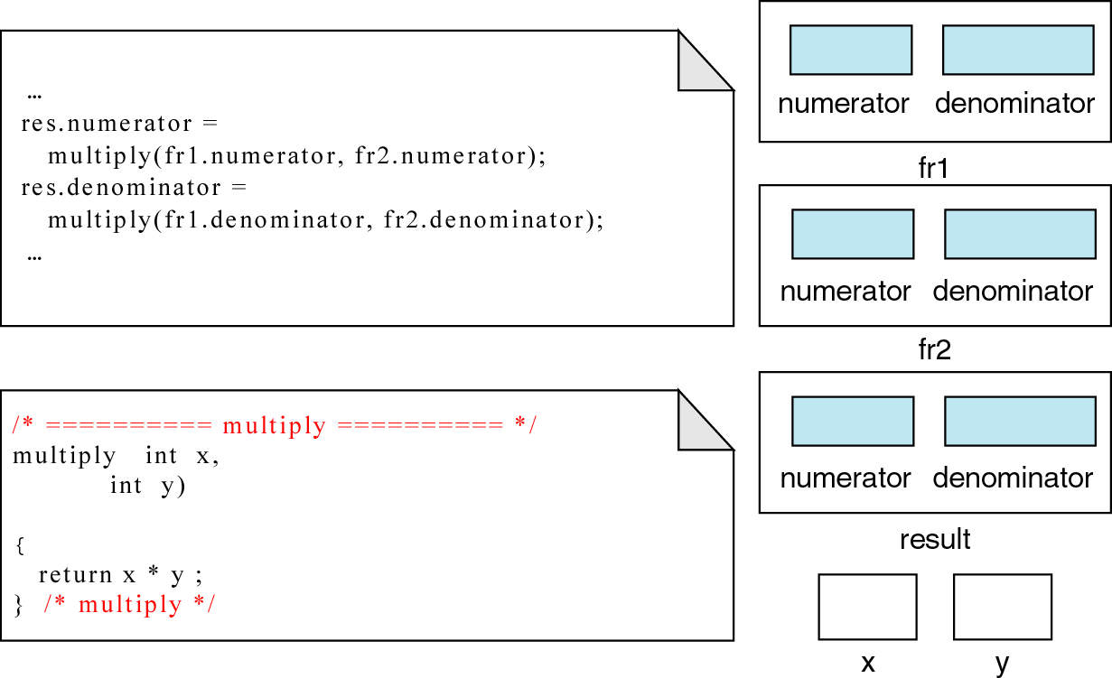
Figure 12-21 Passing structure member to functions

Slide 59
Structures and Functions
2. Sending the whole structure (since structure is a type)
Better solution is to pass the entire structure to the function so that function can finish its job in one call
Actual parameters – use the structure type for declaring the parameters
Formal parameters –
  Similarly specify the structure as type in the formal parameters of the called function
  Similarly return can be specified as the structure type

Slide 60
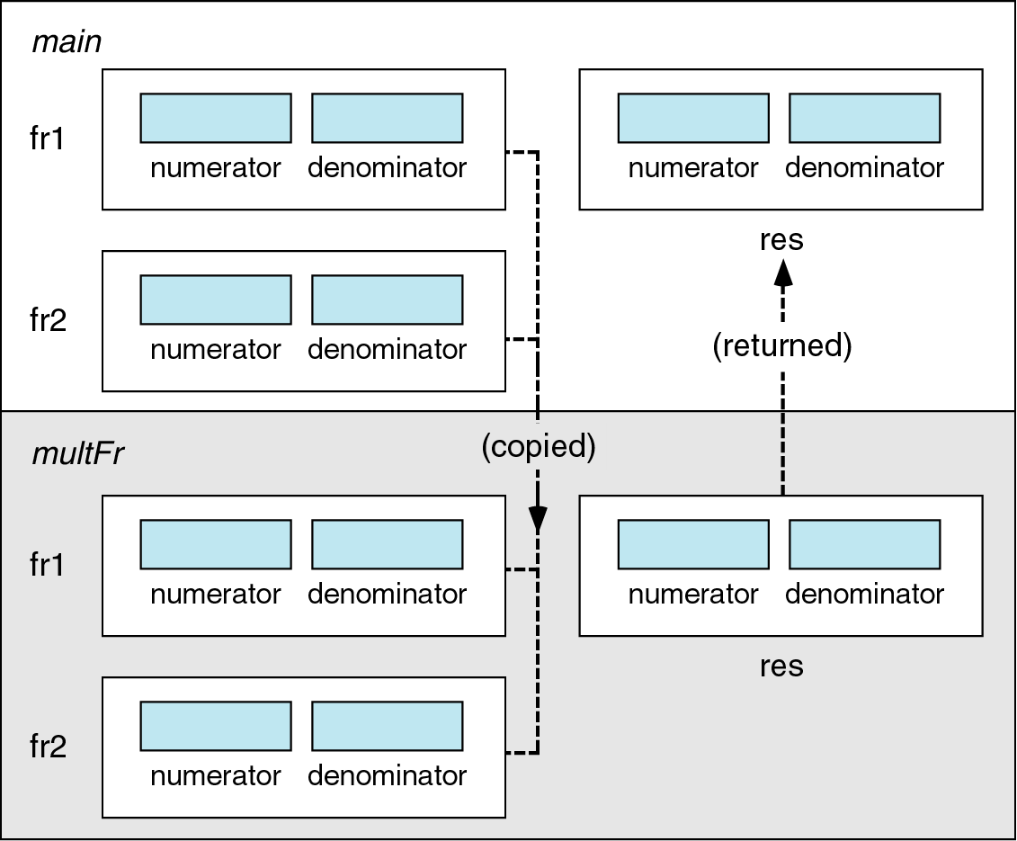
Figure 12-22 Passing and returning structures

Slide 61
Structures and Functions
Sending the whole structure
typedef struct
{
int numerator;
int denominator;
} FRACTION;
FRACTION get();
FRACTION multFr ( FRACTION fr1, FRACTION fr2);
FRACTION print (FRACTION fr1, FRACTION fr2, FRACTION result )
int main() {
FRACTION fr1, fr2, res;
fr1= get ();
fr2 = get ();
res = multFr (fr1, fr2);
printFr (fr1, fr2, res);
}
FRACTION get () {
FRACTION fr;
printf(“write fraction in the form of x/y”);
scanf(“%d %d”, &fr.numerator, &fr. denominator);
return fr;
}

Slide 62
Structures and Functions
FRACTION multFr (FRACTION fr1, FRACTION fr2) {
FRACTION res;
res.numerator = fr1.numerator * fr2. numerator;
res. denominator = fr1. denominator * fr2. denominator;
return res;
}
FRACTION printFr (FRACTION fr1, FRACTION fr2, FRACTION res) {
printf(“%d %d”, res.numerator, res. denominator);

Slide 63
Structures and Functions
2. Sending the whole structure (since structure is a type)
In get() function, address and member operator both are used
  Member operator has more priority, so parentheses are not required
In get() function, two values are returned without even using pointers
  Using structures, it is possible to return more than one element

Slide 64
Structures and Functions
3. Passing structures through pointers

Slide 65
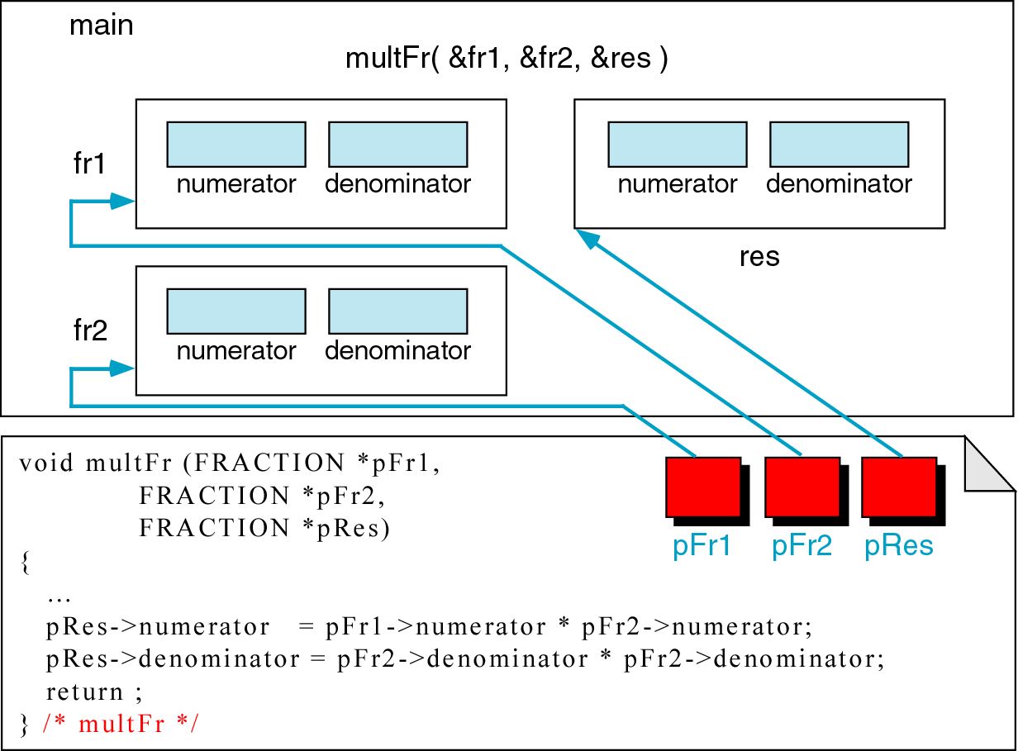
Figure 12-23 Passing structures through pointers

Slide 66
Structures and Functions
3. Passing structures through pointers
typedef struct
{
int numerator;
int denominator;
} FRACTION;
void get(FRACTION *pFr);
void multFr ( FRACTION *pFr1, FRACTION *pFr2, FRACTION *pRes);
void printFr (FRACTION *pRes)
int main(){
FRACTION fr1, fr2, res;
get ( &fr1);
get ( &fr2);
res = multFr ( &fr1, &fr2, &res);
printFr (&res);
}
void get (FRACTION *pFr) {
printf(“write fraction in the form of x/y”);
scanf(“%d %d”, &pFr -> numerator, &(*pFr). denominator);
}

Slide 67
Structures and Functions
void multFr (FRACTION *pFr1, FRACTION *pFr2, FRACTION *pRes) {
pRes -> numerator = pFr1 -> numerator * pFr2 -> numerator;
pRes -> denominator = pFr1 -> denominator * pFr2 -> denominator;
}
void printFr (FRACTION *pRes) {
printf(“%d %d”, pRes -> numerator, pRes -> denominator);

Slide 68
Structures and Functions
3. Passing structures through pointers
scanf (“%d %d”, &pFr -> numerator, &(*pFr). denominator
Even with pointers, we need address for scanf
Two notations are equivalent
Selection operator -> has higher priority than address operator &
  Parentheses are not required
Member operator has a higher priority than indirection operator * and address operator &
  But & and . are at the same level, so we need parentheses only for *

Slide 69
END

